Slide 1
CSE 260
Digital Logic Design
Walid Mohammad

Slide 2
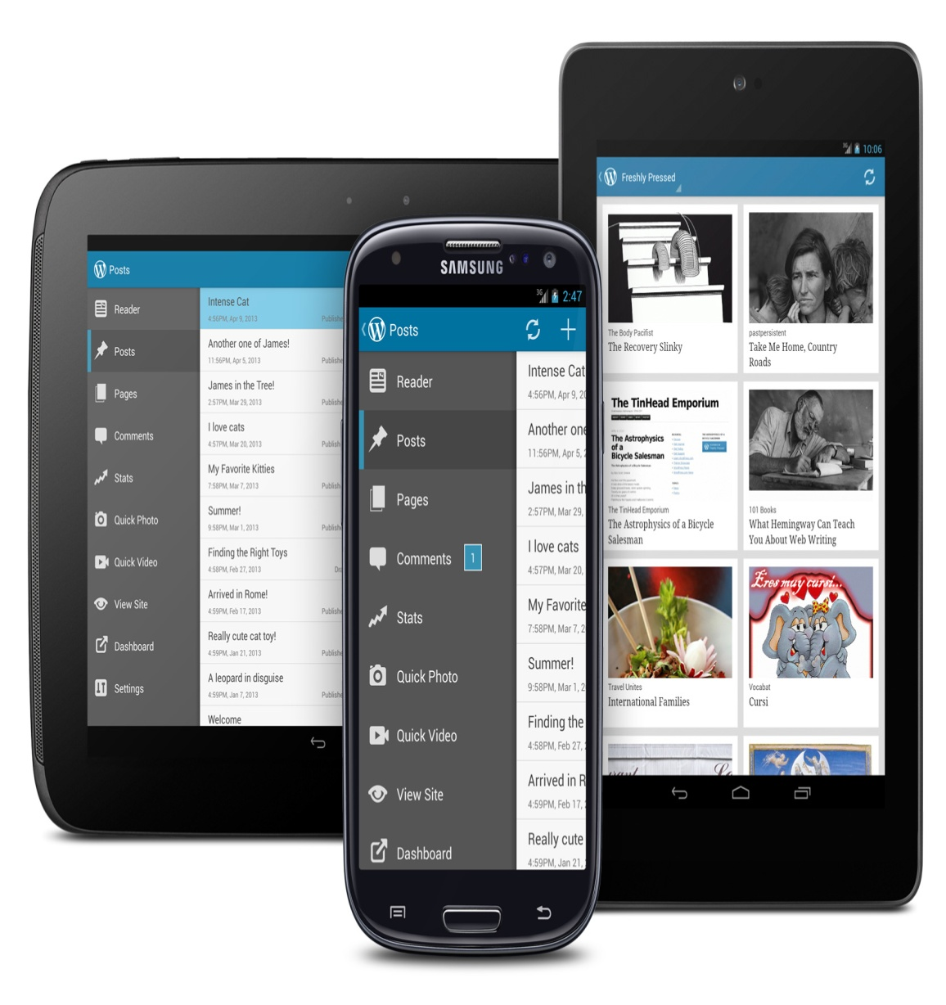
??????
PHONE or TAB
Please
Switch Phones OFF
or
Put them on SILENT
Lecture -1

Slide 3
Mark Distribution
Participation & Attendance 5
Assignments( 5 to 6) 5
Quiz 10
Lab 25
Midterm Exam 20
Final Exam 35

Slide 4
Text Books:
Core Texts:
Digital Logic And Computer Design, Morris Mano
( Please buy hard copy, do not follow the soft copy available in internet)
Reference material:
Digital Design Principles and Practices, John F. Wakerly
( Softcopy provided in TSR)
Lecture -1

Slide 5
Teaching Staff:
Name: Walid Mohammad (WAM)
Room: UB 50411,
Email :
walidmohammad51@gmail.com,
walid.mohammad@bracu.ac.bd
Subject:
[CSE260] [Sec – XX] Name, ID
Teaching Assistant ( to be appointed) will be there for your support
Consultation Hours: tsr\spring\CSE\WAM
Appointment by email !
Lecture -1

Slide 6
Objective
Distinguish between analog and digital system
Understand the advantage and limitation of digital system
Understand the meaning of digital logic

Slide 7
Analog vs. Digital
Analog data can vary over a continuous range of values. Example: speedometer
Digital quantities can take on only discrete values (0 and 1, high and low). Example: Digital Computer, Decimal Digits, Alphabets

Slide 8
Digital System
A digital system is a combination of devices designed to manipulate physical quantities or information that are represented in digital form.
“A discreet information processing system”
Signals: Discreet information

Slide 9
Advantage of digital system
Greater accuracy or precision
Easier to design (generality)
Easier information storage
Programmability (instructions)
Speed
Economical

Slide 10
Limitation of digital technology
The real world is mainly analog

Slide 11
Overcome the limitation
Convert the real world analog input data into digital one
Process this digital data
Then again convert into analog form

Slide 12
Digital logic
Design logic is a term used to denote the design and analysis of digital system
Digital logic is concerned with the interconnection among digital components and modules
Digital logic design is engineering and engineering means problem solving

Slide 13
Number systems and codes
Digital Systems are built from circuits that process binary digits. BUT very few real-life problems are based on binary numbers.
SO a digital system designer must establish some correspondence between the binary digits processed by digital circuits and real-life numbers, events and conditions.

Slide 14
Information representation
Human decisions tends to be binary i.e. Yes or No
Elementary storage units inside computer are electronic switches. Each switch holds one of two states: on (1) or off (0).
We use a bit (binary digit), 0 or 1, to represent the state.
ON
OFF

Slide 15
Information representation
Storage units can be grouped together to cater for larger range of numbers. Example: 2 switches to represent 4 values.
0 (00)
1 (01)
2 (10)
3 (11)

Slide 16
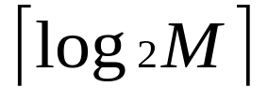
Information representation
In general, N bits can represent 2^{N} different values.
For M values, bits are needed.
1 bit → represents up to 2 values (0 or 1)
2 bits → rep. up to 4 values (00, 01, 10 or 11)
3 bits → rep. up to 8 values (000, 001, 010. …, 110, 111)
4 bits → rep. up to 16 values (0000, 0001, 0010, …, 1111)
32 values → requires 5 bits
64 values → requires 6 bits
1024 values → requires 10 bits
40 values → requires 6 bits
100 values → requires 7 bits

Slide 17
Positional Notations
Decimal number system, symbols = { 0, 1, 2, 3, …, 9 }
Position is important
Example:(7594)₁₀ = (7x10³) + (5x10²) + (9x10¹) + (4x10⁰)
In general, (a_{n}a_{n-1}… a₀)₁₀ = (a_{n} x 10^{n}) + (a_{n-1} x 10^{n-1}) + … + (a₀ x 10⁰)
(2.75)₁₀ = (2 x 10⁰) + (7 x 10⁻¹) + (5 x 10⁻²)
In general, (a_{n}a_{n-1}… a₀ . f₁f₂ … f_{m})₁₀ = (a_{n} x 10^{n}) + (a_{n-1}x10^{n-1}) + … + (a₀ x 10⁰) + (f₁ x 10⁻¹) + (f₂ x 10⁻²) + … + (f_{m} x 10^{-m})

Slide 18
Other Number Systems
Binary (base 2): weights in powers-of-2. Binary digits (bits): 0,1.
Octal (base 8): weights in powers-of-8. Octal digits: 0,1,2,3,4,5,6,7
Hexadecimal (base 16): weights in powers-of-16. Hexadecimal digits: 0,1,2,3,4,5,6,7,8,9,A,B,C,D,E,F
Note: when base is r, coefficient values range from 0 to r-1.

Slide 19
Other Number System
Binary (base 2): weights in powers-of-2. Binary digits (bits): 0,1.
Octal (base 8): weights in powers-of-8. Octal digits: 0,1,2,3,4,5,6,7
Hexadecimal (base 16): weights in powers-of-16. Hexadecimal digits: 0,1,2,3,4,5,6,7,8,9,A,B,C,D,E,F
Binary | Octal | Decimal | Hexadecimal
0000 | 0 | 0 | 0
0001 | 1 | 1 | 1
0010 | 2 | 2 | 2
0011 | 3 | 3 | 3
0100 | 4 | 4 | 4
0101 | 5 | 5 | 5
0110 | 6 | 6 | 6
0111 | 7 | 7 | 7
1000 | 10 | 8 | 8
1001 | 11 | 9 | 9
1010 | 12 | 10 | A
1011 | 13 | 11 | B
1100 | 14 | 12 | C
1101 | 15 | 13 | D
1110 | 16 | 14 | E
1111 | 17 | 15 | F
Notes:
Farazul H Bhuiyan
Lecturer
Dept. of CSE
BRAC University
Bangladesh

Slide 20
Base-R to Decimal Conversion
***Formula= ∑ digit * source_base ^{position}
(1101.101)₂ = 1×2³ + 1×2² + 1×2⁰ + 1×2⁻¹ + 1×2⁻³ = 8 + 4 + 1 + 0.5 + 0.125
= (13.625)₁₀
(572.6)₈ = 5×8² + 7×8¹ + 2×8⁰ + 6×8⁻¹ = 320 + 56 + 2 + 0.75 = (378.75)₁₀
(2A.8)₁₆ = 2×16¹ + 10×16⁰ + 8×16⁻¹ = 32 + 10 + 0.5 = (42.5)₁₀
(341.24)₅ = 3×5² + 4×5¹ + 1×5⁰ + 2×5⁻¹ + 4×5⁻² = 75 + 20 + 1 + 0.4 + 0.16 = (96.56)₁₀

Slide 21
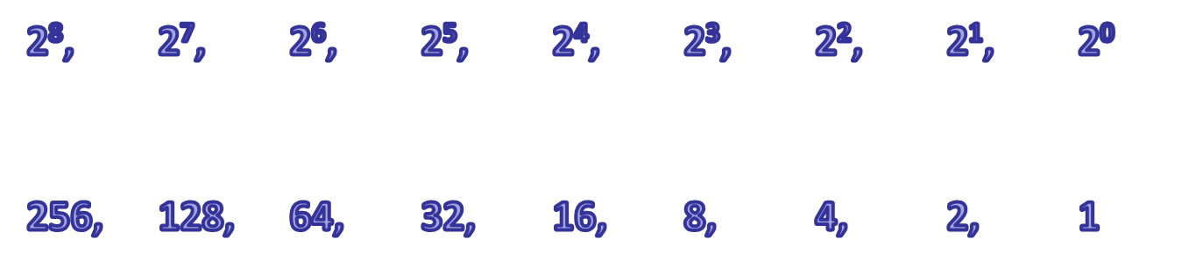
Decimal-to-Binary Conversion
Works for binary
Method 1: Sum-of-Weights Method
Note: Remembering the below value helps
Method 2:
  Repeated Division-by-2 Method (for whole numbers)
  Repeated Multiplication-by-2 Method (for fractions)
Works for all base

Slide 22
Sum-of-Weights Method
Determine the set of binary weights whose sum is equal to the decimal number.
(9)₁₀ = 8 + 1 = 2³ + 2⁰ = (1001)₂
(18)₁₀ = 16 + 2 = 2⁴ + 2¹ = (10010)₂
(58)₁₀ = 32 + 16 + 8 + 2 = 2⁵ + 2⁴ + 2³ + 2¹
= (111010)₂
(0.625)₁₀ = 0.5 + 0.125 = 2⁻¹ + 2⁻³
= (0.101)₂

Slide 23
Conversion between Decimal and other Bases
Decimal to base-R
  whole numbers: repeated division-by-R
  fractions: repeated multiplication-by-R

Slide 24
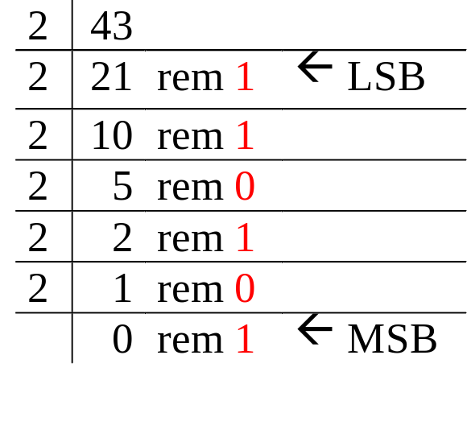
Repeated Division-by-2 Method
To convert a whole number to binary, use successive division by 2 until the quotient is 0. The remainders form the answer, with the first remainder as the least significant bit (LSB) and the last as the most significant bit (MSB).
(43)₁₀ = (101011)₂

Slide 25
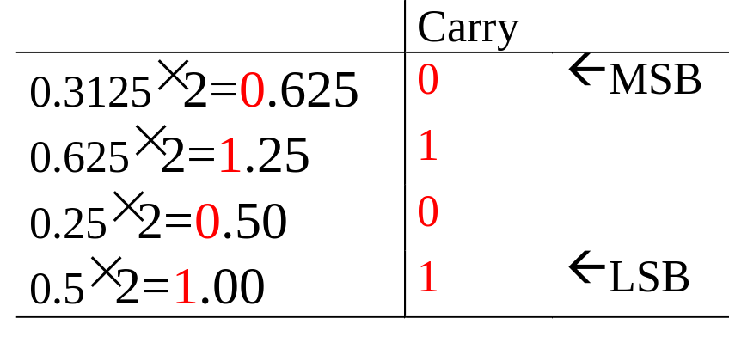
Repeated Multiplication-by-2 Method
To convert decimal fractions to binary, repeated multiplication by 2 is used, until the fractional product is 0 (or until the desired number of decimal places). The carried digits, or carries, produce the answer, with the first carry as the MSB, and the last as the LSB.
(0.3125)₁₀ = (.0101)₂

Slide 26
Note: difference between conversion of integer and fraction
Integer
Fraction
Division by base of target no. system
Remainders are accumulated
By division we obtain LSB to MSB
Multiplication by base of target no. system
Integers are accumulated
By multiplication we obtain MSB to LSB

Slide 27
Conversion between Bases
In general, conversion between bases can be done via decimal:
Base-2 Base-2
Base-3 Base-3
Base-4 Decimal Base-4
… ….
Base-R Base-R

Slide 28
Binary-Octal/Hexadecimal Conversion
Binary → Octal: Partition in groups of 3
  (10 111 011 001 . 101 110)₂ = (2731.56)₈
Octal → Binary: reverse
  (2731.56)₈ = (10 111 011 001 . 101 110)₂
Binary → Hexadecimal: Partition in groups of 4
  (101 1101 1001 . 1011 1000)₂ = (5D9.B8)₁₆
Hexadecimal → Binary: reverse
  (5D9.B8)₁₆ = (101 1101 1001 . 1011 1000)₂

Slide 29
Exercise:
(1)Try converting this to
(10110001101011.111100000110)₂
octal b) hexadecimal
(2) Try converting these to binary
a) (673.124)₈
b) (306.D)₁₆

Slide 30
Answers:
a) (26153.7406)₈
(1) b) (2C6B.F06)₁₆
_{(2) a)} (110 111 011 . 001 010 100)₂
_{(2) b)} (0011 0000 0110 . 1101)₂

Slide 31
Binary operations: Addition: Addition Rules w/Carries
For 2 bit
For 3 bit
0 + 0 = 0 0 ( 0 with a 0 carry )
0 + 1 = 0 1 ( 1 with a 0 carry )
1 + 0 = 0 1 ( 1 with a 0 carry )
1 + 1 = 1 0 ( 0 with a 1 carry )
0+0+0 = 0 0 (0 WITH 0 CARRY)
0+0+1 = 0 1 (1 WITH 0 CARRY)
0+1+1 = 1 0 (0 WITH 1 CARRY)
1+1+1 = 1 1 (1 WITH 1 CARRY)

Slide 32
Adding Binary Numbers
0
1
1
1
0
0
0
28
+ 43
71
⎯→ 00011100
⎯→ + 00101011
0
1
0
0
0
1
1
1

Slide 33
Binary operations: Addition
From right to left, we add each pair of digits
We write the sum, and add the carry to the next column on the left
1 9 8
+ 2 6 4
Sum
Carry
0 1 1
+ 0 0 1
Sum
Carry
4
0
6
1
2
1
1
0
0
1
0
1

Slide 34
Exercise
3(a) Add (101101) ₂ with (100111) ₂

Slide 35
Solution
3(a) (1010100) ₂
_{Working:}
Augend: 101101
Addend: +100111
Sum: 1010100

Slide 36
Addition of base-r
Example:
(34)₅+ (41)₅+ (24)₅
21
(34)₅
(41)₅
+ (24)₅
________________
(2 0 4)₅
4+1+4= 9
9%5=4
9/5=1 (carry)
1+3+4+2= 10
10%5=0
10/5=2 (carry)

Slide 37
Exercise
Try:
2 (a) (FF)₁₆+(F1)₁₆
2 (b) (66)₇ + (55)₇

Slide 38
Solution
2(a) (1F0) ₁₆
2(b) (154) ₇

Slide 39
Binary Multiplication
The multiplication of two binary numbers can be carried out in the same manner as the decimal multiplication.
Unlike decimal multiplication, only two values are generated as the outcome of multiplying the multiplication bit by 0 or 1 in the binary multiplication. These values are either 0 or 1.
The binary multiplication can also be considered as repeated binary addition. Therefore, the binary multiplication is performed in conjunction with the binary addition operation.

Slide 40
Binary Multiplication
A | B | A×B
0 | 0 | 0
0 | 1 | 0
1 | 0 | 0
1 | 1 | 1
Example : Perform the binary multiplication of the decimal numbers 12 and 10.
The equivalent binary representation of the decimal number 12 is 1100.
The equivalent binary representation of the decimal number 10 is 1010.
 |  |  | 1 | 1 | 0 | 0
 |  |  | 1 | 0 | 1 | 0
 |  |  | 0 | 0 | 0 | 0
 |  | 1 | 1 | 0 | 0
 | 0 | 0 | 0 | 0
1 | 1 | 0 | 0
1 | 1 | 1 | 1 | 0 | 0 | 0
×

Slide 41
Exercise
6 (a) Multiply 1011 with 101

Slide 42
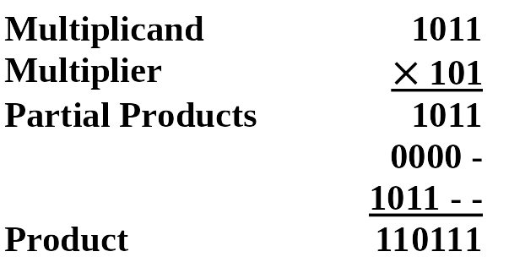
Solution

Slide 43
Multiplication with base-r
Working
2A3C
xB7
------------
127A4
1D094
------------
1E30E4
7*C = 7*12 = 84 =(write 4, carry 5)
7*3+5 = 26 = 1A (write A, carry 1)
7*A+1 = 71 = 0x47 (write 7, carry 4)
7*2+4 = 18 = 0x12
This completes the 7*2A3C = 127A4 partial product.
B*C = 11*12 = 132 = (write 4, carry 8)
B*3+8 = 11*3+8 = 41 = (write 9, carry 2)
B*A+2 = 11*10+2 = 112 = (write 0, carry 7)
B*2+7 = 11*2+7 = 29 = 1D
This completes the B[0]*2A3C = 1D094[0] partial product, where I'm noting the [0] digits to remind us this is in the 16s column.
Adding the partial products: 127A4 + 1D0940
4+0 = 4
A+4 = E
7+9 = 16 = 0x10 (write 0, carry 1)
2+0+1 = 3
1+D = E
1 = 1

Slide 44
Exercise
7 (a) Multiply (34)5 with (42)5
7 (b) Multiply (25)9 with (36)9

Slide 45
Solution
7 (a) (3133)5
7 (b) (1033)9

Slide 46
Binary operations:
Subtraction Rules w/Carries
For 2 bit
0 - 0 = 0 0 ( 0 with a 0 carry )
1 - 1 = 0 0 ( 0 with a 0 carry )
1 - 0 = 0 1 ( 1 with a 0 carry )
0 - 1 = ? ( ???)

Slide 47
Subtracting Binary Numbers: approach 1
2
0
2
- 1
1
⎯→ 10
⎯→ - 01
0
1

Slide 48
Subtracting Binary Numbers: approach 2
1
1
0
1
1
4
- 1
3
⎯→ 100
⎯→ - 001
0
1
1

Slide 49
Exercise
5(b) Subtract (100111) ₂ from (101101) ₂

Slide 50
Solution
5 (b) (000110) ₂
_{Working:}
5(b)Subtraction
Minuend: 101101
Subtrahend: −100111
Difference: 000110

Slide 51
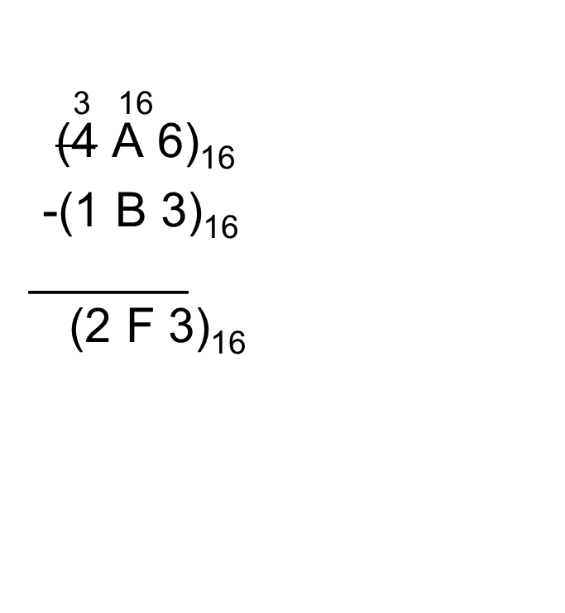
Subtraction of Base-r
4 6
(54)₆
- (35)₆
_____________
(15)₆

Slide 52
Exercise
4 (a) (71)₈-(56)₈
4(b) (21)₃-(12)₃

Slide 53
Solution
4 a) (13)₈
4 b) (2)₃

